Slide 1
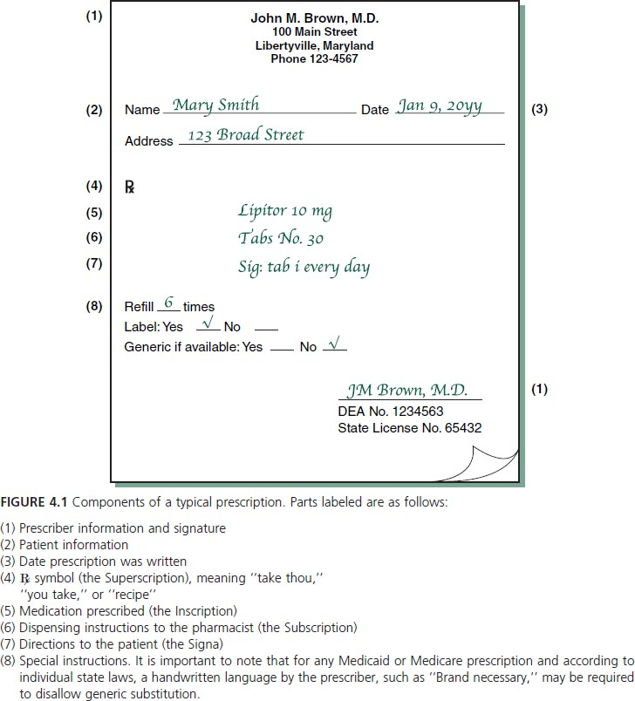
Lec (2) Lecturer Noor Yousif Fareed
Interpretation of prescription and medication orders
A prescription is an order for medication issued by a physician, dentist, or other properly licensed medical practitioner, designates a specific medication and dosage to be prepared by a pharmacist and administered to a particular patient.
The information generally found on a completed prescription is shown in Figure 4.1.

Slide 2
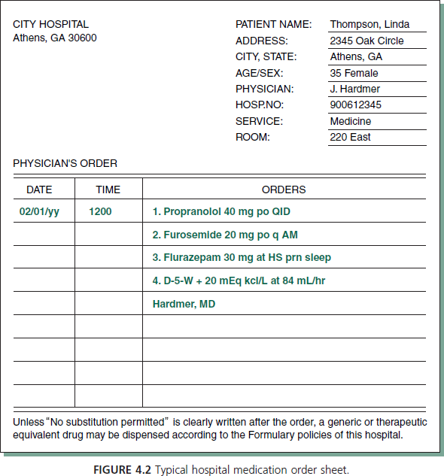
In hospitals and other institutions, the forms are somewhat different and are referred to as medication orders. A typical medication order sheet is shown in Figure 4.2.
A prescription or medication order for an infant, child, or an elderly person may also include
age,
weight, and/or
body surface area (BSA) of the patient.

Slide 3
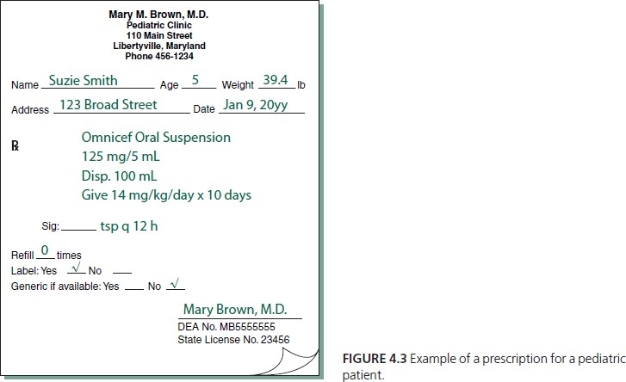
An example of a prescription written for a pediatric patient is shown in Figure 4.3. This information is sometimes necessary in calculating the appropriate medication dosage.
It is important to recognize two broad categories of prescriptions:
Those written for a single component or prefabricated product and not requiring compounding or admixture by the pharmacist,
Those written for more than a single component and requiring compounding.
A prescription may include the chemical or nonproprietary (generic) name of the substance or the manufacturer’s brand or trademark name.

Slide 4
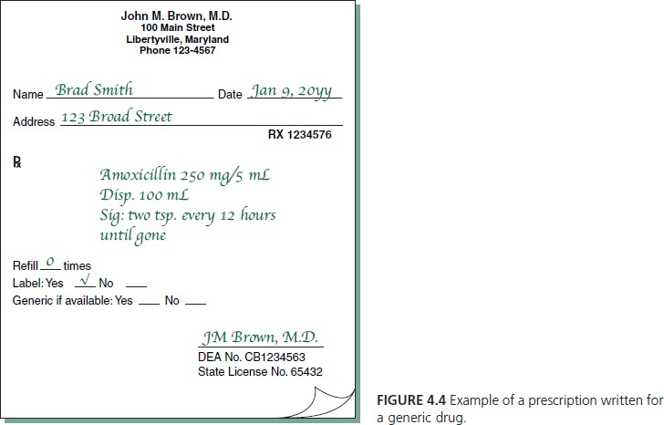
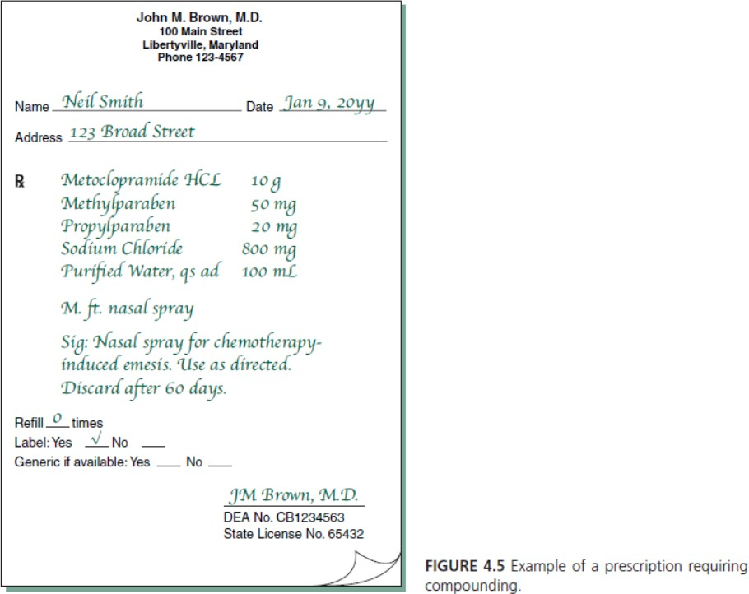
Examples are shown for prescriptions calling for trade-name products (Fig. 4.1 and Fig. 4.3), a generic drug (Fig. 4.4), and compounding (Fig. 4.5).

Slide 5
E- prescribing/ e- prescriptions:
A medication order, for a patient is entered into an automated data entry system as a personal computer (PC) or a handheld device loaded with e-prescribing software and sent to a pharmacy as an e-prescription.
When received, a pharmacist immediately reduces the order to a hard copy and/or stores it as a computer file.
Prescription and medication order accuracy
It is the responsibility of the pharmacist to ensure that each prescription and medication order given in correct form, each medication should be:
therapeutically appropriate for the patient;
prescribed at the correct dose;
dispensed in the correct strength and dosage form;
correctly labeled with complete instructions for the patient or caregiver; and
for the patient in a hospital or other health care facility, each medication must be administered to the correct patient, at the correct time, and by the correct rate and route of administration.
Use of Roman numerals on prescriptions
Roman numerals commonly are used in prescription writing to designate quantities, as the:
quantity of medication to be dispensed and/or
quantity of medication to be taken by the patient per dose.

Slide 6
The following rules apply in the use of Roman numerals:
A letter repeated once or more, repeats its value (e.g., xx = 20; xxx = 30).
One or more letters placed after a letter of greater value increases the value of the greater letter (e.g., vi = 6; xij = 12; lx = 60).
A letter placed before a letter of greater value decreases the value of the greater letter (e.g., iv= 4; xl = 40).
Capital or lower case letters may be used. A ‘‘j’’ may be used as the final ‘‘i’’ in a sequence (e.g., viij).
Use of abbreviation and symbols
The use of abbreviations is common on prescriptions and medication orders. Some are derived from the Latin through its historical use in medicine and pharmacy, whereas others have evolved through prescribers’ use of writing shortcuts. A list of some of these abbreviations is presented in Table 4.2.

Slide 7
TABLE 4.2 SELECTED ABBREVIATIONS , ACRONYM S, AND SYMBOLS USED IN PRESCRIPTIONS AND MEDICATION ORDERsa, b
ABBREVIATl ON (LATIN ORIGIN') | MEANING | ABBREVIATION (LATIN ORIGIN') | MEANING
Prescriptio n Fill ing | Directions | pt. | pint
aa. or (ana)
ad (ad)
disp. (dispensatur) div. (dividatur)
d.t.d. (dentur tales
doses)
ft (fiat)
M. (mice)
No. (numero)
non rep. or NR (no n repatat ur)
q.s. (quan tum suff icit )
q.s. ad (quant um suff iciat ad)
Sig. (Sig n a)
of each
up to; to make dispense divide
give of such doses
qt.
quart one half
t ablespoonfu l
teaspoonful
ss or ss (semissem
tb sp.
tsp.
Signa/Patient Inst ruct ions
make mix number
do not repeat
a.c. (ante cibos) adlib. (ad libitum) admin
A.M. (ante meridiem)
aq. (aqua)
ATC
b.i.d. (bis in die)
c or e (cum)
d (die)
d il. (dilutus)
et
h. or hr. (hora)
h.s. (hora somni)
i.e. (inter cibos)
min. (minutum)
m&n
N&V
noct. (nocte) NPO (non per os)
p.c. (post cibos)
P.M. (post
meridiem)
p.o. (per os)
p.r.n. (pro re nata)
q (quaque)
qAM
q4h, q8h, etc.
q.i.d. (quarter in die)
rep. (repetatur)
s (sine)
s.i. d . (semel in die)
s.o.s. (si opus sit)
before meals
at pleasure, fr eely administer
morning
a suff icient quant ity
wat er
around the clock
twice a day with
day dilute and hour
at bedtime
between meals minute
morning and night nausea and vomit ing
night
noth ing by mout h
after meals afternoon; evening
a sufficient quantity to make
writ e (directions
on label)
Quant it ies and Measu reme nt
cmBSA
³
body surface area cubic cent imeter
or mill iliter (ml ) flu id
fluid dram (;,;,
teaspoo nfu l, 5 ml ) hal f -fl u idounce (;,;,
tablespoonfu, l 15ml )
gram gallon drop pound kilog ram liter
squa r e meter microg ram
mill iequiva lent
milligram
mill igrams (of drug) per kilogram (of body weight)
mill ig rams (of drug) per squar e meter (of body surface area)
milliliter
millilit ers (of drug administ ered) per hour (as throug h int ravenous administ r ation)
mill iosmoles
ounce
for fl (fl uidus) fl3 or f3
f15ss orf 5ss
g
gal
gtt (gutta)
lb (/ibra)
kg l
m² or M² mcg mEq
mg
mg/kg
by mouth (orally) as needed
every
every morning every _ hours four times a day
repeat wit hout
once a day
if t here is need; as
needed
immediately
t hree t imes a day as d ir ected
week
mg/m ²
stat. (st atim)
t.i.d. (ter in die)
ut diet. (ut dictum)
wk.
Medications APA P
ASA A ZT
mL
mUh
acetaminophen aspiri n zidovudine
mOsm or mOsmol oz.
(continued )

Slide 8
TABLE 4.2 Continued
ABBREVIATION
(LATIN ORIGIN') EES
MEANING
erythromycin ethylsuccin ate
hydrocortisone
hydroch lorot hiazide methotrexate
ni troglycer in
ABBREVIATION (LATIN ORIGIN')
DSNS
MEANING
dextrose 5% in normal sal ine (0.9% sodium chlor ide)
dextrose 5% in water
dextrose 10% in water elixir
in ject ion norma l saline
h alf-strengt h norma l
sal ine
ointment
HC HCTZ MD< NTG
Clinical BM
BP
BS CHO CHF GERO
DSW 010W
elix.
inj. NS
½NS
bowe l movement b l ood preasure
b l ood sugar
coronary heart disease congestive heart failure gastroint estina l r eflux
disease gastroint estina l
gl om erular fi ltrat ion rate genit ourinary
headache
hi gh blood pressure
hormone replacement therapy
hypertension intraocular pressure myocardial ischem ia/
infarct ion osteoarthrit is patient
shortness of breath
tot al parenteral nut rit ion
upper respiratory
infect ion
ur inary tract infection
oint or ungt.
(unguentum)
pulv. (pulvis )
R, L R/L or LR
powder
Ringer's Lactate or Lactated Ringer 's
solution supposito ry
GI GFR GU HA HBP HRT
sol. (solut i o)
supp.
(supposi tor ium )
susp.
syr. (syrupus)
tab. (tabletta)
suspension syrup tablet
HT or HTN IOP
Ml
Routes of Administrat ion
CIVI
continuous (24 hour) intravenous infusion
intradermaI int r amuscular int rathecal intravenous
intravenous bolus intravenous infusion intravenous push intravenous piggy back nasogastr i c tube
by mouth
rectal or rectum sublingual subcutaneously topically
vag inally
OA
Pt
SOB TPN URI
ID I M IT IV
IVB
IV Drip IVP IVPB NGT
p.o. or PO (per os)
rect .
SL
SubQ Top. Vor PV
UTI
Dosage Forms /Vehicles
amp. cap. DSLR
ampul
capsule
dextrose 5% in lactated Ring er's

Slide 9
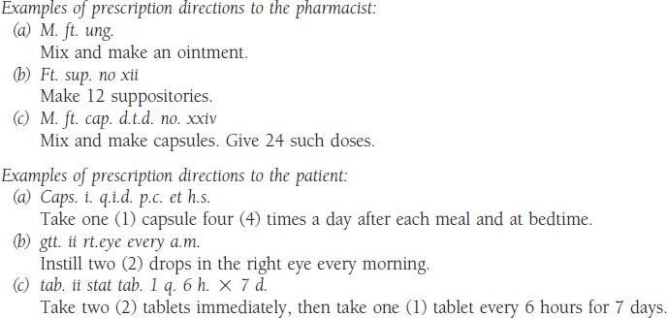
The portions of the prescription presenting directions to the pharmacist (the Subscription) and the directions to the patient (the Signa) commonly contain abbreviated forms of English or Latin terms as well as Arabic and Roman numerals.
Medication scheduling and patient compliance
Medication scheduling may be defined as the frequency (i.e., times per day) and duration (i.e., length of treatment) of a drug’s prescribed or recommended use.
Frequency of medication scheduling is influenced by
The patient’s physical condition
The nature and severity of the illness
The condition being treated.

Slide 10
Patient compliance is defined as patient understanding and adherence to the directions for use.
Compliance includes taking medication at the desired strength, in the proper dosage form, at the appropriate time of day and night, at the proper interval for the duration of the treatment.
Patient noncompliance is the failure to comply with a practitioner’s or labeled direction in the self-administration of any medication. Noncompliance may involve underdosage or overdosage, inconsistent or sporadic dosing, incorrect duration of treatment, and drug abuse or misadventuring with medications.
Causes of patient non compliance:
unclear or misunderstood directions,
undesired side effects of the drug that discourage use,
lack of patient confidence in the drug and/or prescriber,
discontinued use because the patient feels better or worse,
economic reasons based on the cost of the medication,
absence of patient counseling and understanding of the need for and means of compliance,
confusion over taking multiple medications.
Consequences of patient non compliance
worsening of the condition,
the requirement of additional and perhaps more expensive and extensive treatment methods or
surgical procedures, otherwise unnecessary hospitalization, and
increased total health care cost.

Slide 11
Some of the different types of problems relating to patient compliance with medication are exemplified by the following examples.
How many milliliters of medicine should be dispensed?
Answer: 5 mL times 4 (doses per day) equals 20 mL times 10 (days) equals 200 mL. A pharmacist may calculate a patient’s percent compliance rate as follows:
Example:
What is the percent compliance rate if a patient received a 30-day supply of medicine and returned in 45 days for a refill?

